Slide 1
CHAPTER 5 UNDERSTANDING ELEMENTARY SHAPES
MODULE 2/3
CLASS VI
VIDYA KUBER,
AECS-2, MUMBAI

Slide 2
SECTIONS TO CHAPTER
Discussion on the difficulties in the Exercise 5.1, 5.2 and 5.3.
How to measure an angle?
What are perpendicular lines?
What is a triangle and what are its types?
Homework
Key take-away points

Slide 3
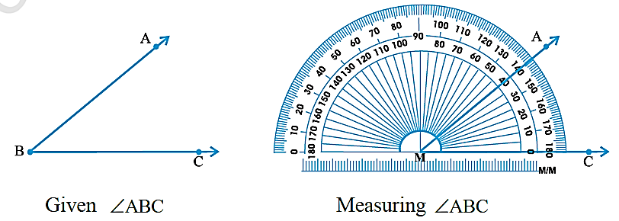
MEASURING ANGLES
We can measure the angle with the help of protractor.
Steps for measuring angle ABC:
Place the protractor so that the mid-point (M in the figure) of its straight edge lies on the vertex B of the angle.

Slide 4
MEASURING ANGLES (cont’d)
Adjust the protractor so that BC is along the straight-edge of the protractor.
There are two ‘scales’ on the protractor: read that scale which has the 0° mark coinciding with the straight-edge (i.e. with ray BC ).
The mark shown by BA on the curved edge gives the degree measure of the angle.
We write m ∠ABC= 40°, or simply ∠ABC= 40°.

Slide 5
PERPENDICULAR LINES
Two lines are said to be perpendicular to each other if two lines intersect each other and the angle formed between them is a right angle.
If PQ is perpendicular to AB then write PQ AB.
P
A
B
Q

Slide 6
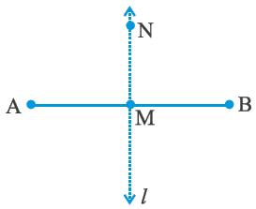
PERPENDICULAR BISECTOR
A perpendicular bisector divides the line segment into two equal parts. If it passes through the mid point of the line segment it also meets the line segment at a right angle.
Let AB be a line segment.
Mark its mid point as M. Let MN be a line perpendicular to AB through M.
Does MN divide AB into two equal parts?
MN bisects AB (that is, divides AB into two equal parts) and is also perpendicular to AB.
So we say that MN is the perpendicular bisector of AB.

Slide 7
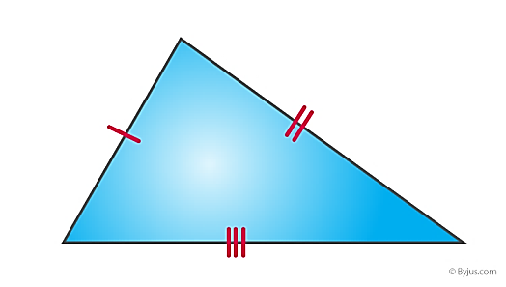
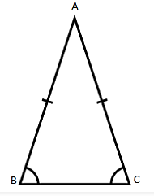
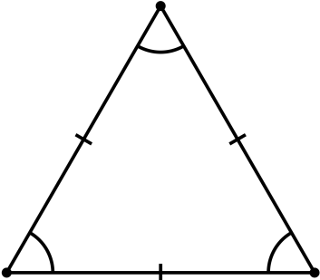
CLASSIFICATION OF TRIANGLES
A polygon with the least number of sides is a triangle.
Triangles on the basis of sides:
Scalene triangle: A triangle which has all three unequal sides is known as a scalene triangle.
Isosceles triangle: A triangle which has two equal sides is known as isosceles triangle.
Equilateral triangle: A triangle which has three equal sides is known as equilateral triangle.

Slide 8
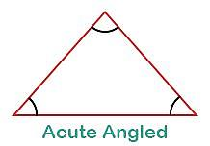
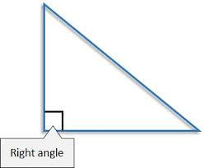
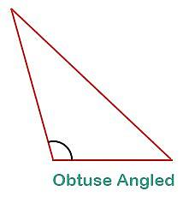
Triangles on basis of angles:
Acute-angled triangle: An acute-angled triangle has all angles less than 90°. All three angles are acute in an acute-angled triangle.
Right-angled triangle: A triangle consisting of one right angle (90°) is known as a right-angled triangle.
Obtuse-angled triangle: A triangle having one angle greater than 90° is called an obtuse-angled triangle.

Slide 9
Recap of what you have learnt
Measuring Angles
To compare two angles exactly, we need the measures of the angles. This is done with the help of a protractor. One complete revolution is divided into 360 parts. Each part is called a degree. The measure of the angle is called ‘degree measure’. We write 360 degrees as 360°.
Perpendicular Lines
If two lines intersect each other and the angle between them is a right angle, then they are called perpendicular lines. If a line AB is perpendicular to line CD, then we write AB ⊥ CD.
Classification of Triangles
We now know that a triangle is a polygon with the least number of sides. There are different types of triangle.

Slide 10
Recap of what you have learnt (cont’d)
Triangles can be classified on the basis of their angles as follows:
If each angle of a triangle is acute, it is called an acute-angled triangle.
If anyone angle of a triangle is a right angle, it is called a right-angled triangle.
If anyone angle of a triangle is obtuse, it is called an obtuse-angled triangle.
The triangles can also be classified on the basis of the lengths of their sides as follows:
If all the three sides of a triangle are of unequal length, it is called a scalene triangle.
If any two of the sides of a triangle are equal, it is called an isosceles triangle.
If all the three sides of a triangle are of equal length, it is called an equilateral triangle.

Slide 11
Homework
NCERT Textbook:
Exercise 5.4
Exercise 5.5
Exercise 5.6

Slide 12
Topics to be learnt in the next session
What is a quadrilateral?
What are polygons?
What are three-dimensional shapes?

Slide 13
THANK YOU!

