Slide 1
CLASS VI CHAPTER 13 MODULE 1
SYMMETRY
-----PREPARED BY
Mrs. SAUMIA NAIR
AECS-6, Mumbai

Slide 2
SPOT THE DIFFERENCES BETWEEN THESE TWO BUTTERFLIES
Unidentical
halves
Identical
halves

Slide 3
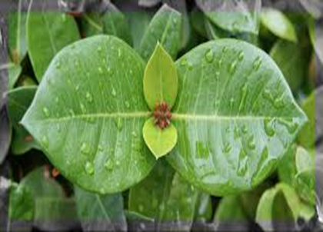
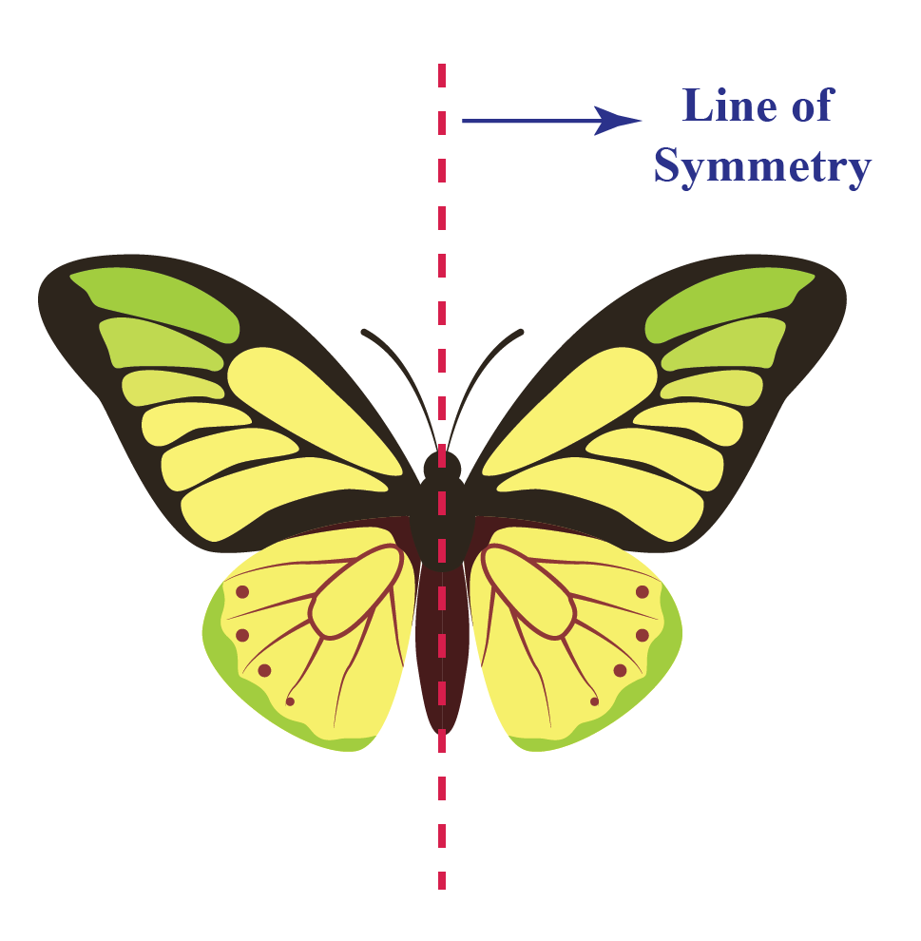
SYMMETRY
OBJECTS OR FIGURES THAT CAN BE DIVIDED INTO TWO MIRROR HALVES ARE SAID TO BE HAVING SYMMETRY.
THE LINE THAT DIVIDES THE FIGURE OR
OBJECT INTO TWO MIRROR HALVES IS
CALLED AS THE LINE OR AXIS OF SYMMETRY.

Slide 4
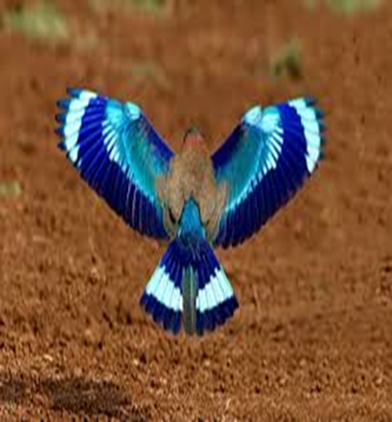
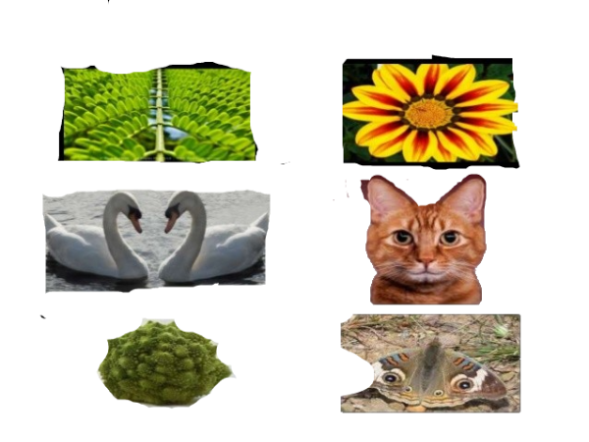
SYMMETRY IN NATURE

Slide 5
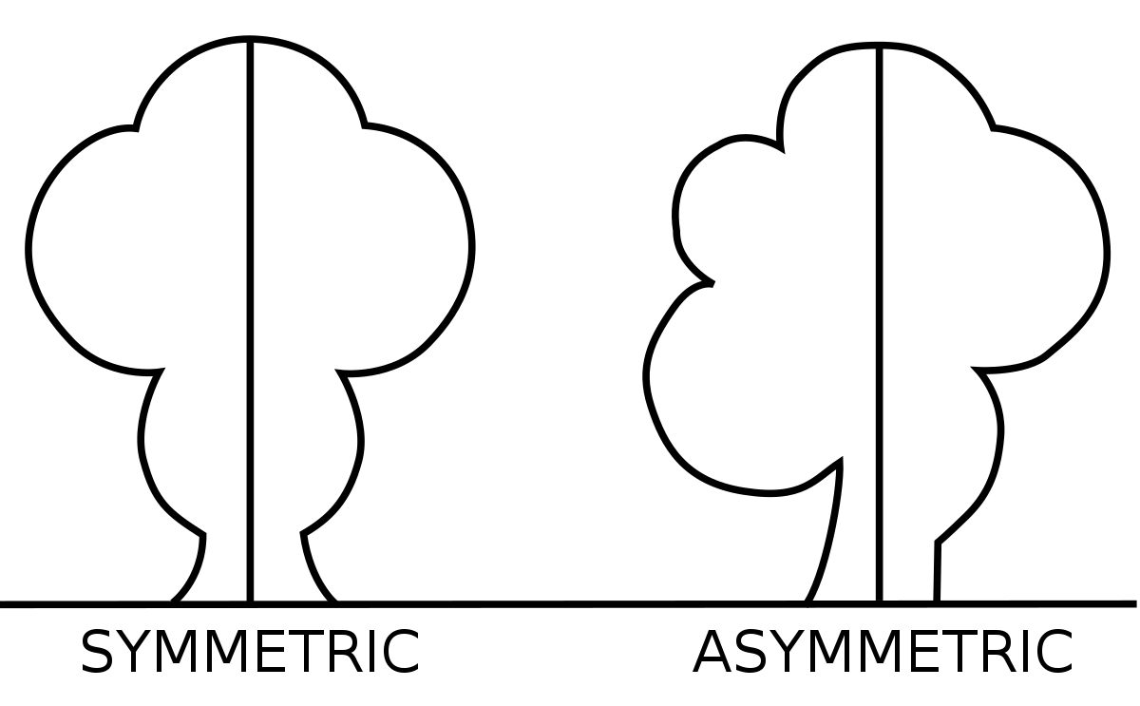
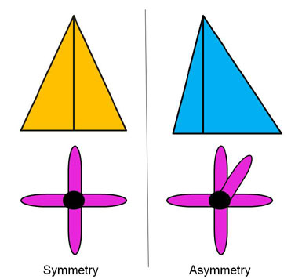
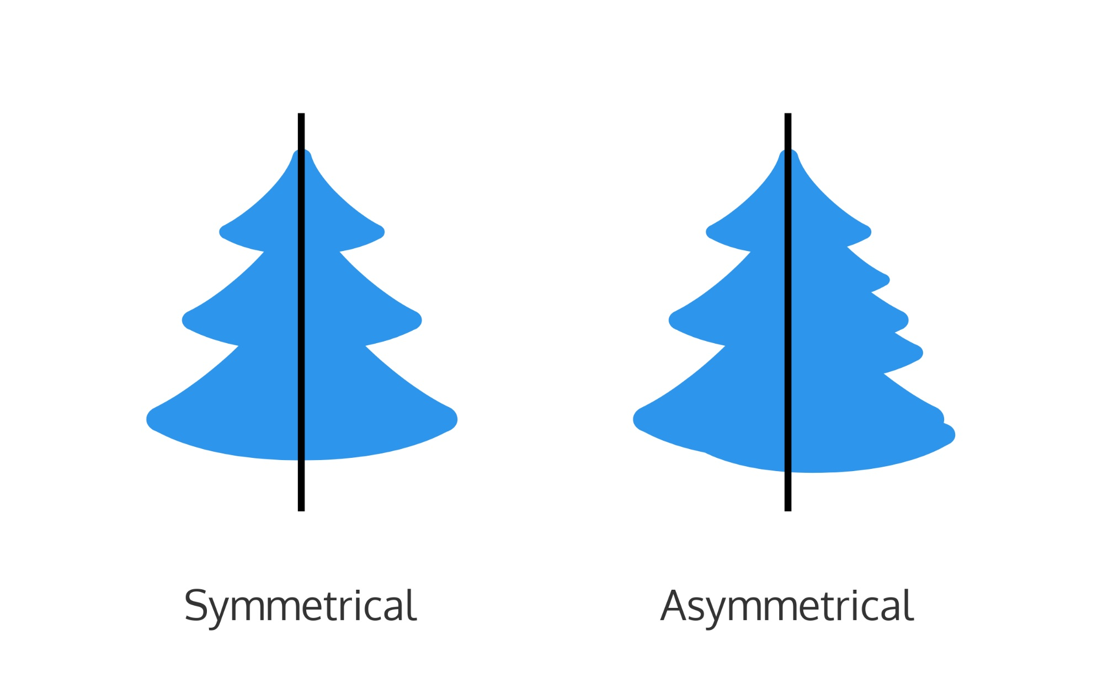
SYMMETRIC AND ASYMMETRIC FIGURES
FIGURES THAT SHOW SYMMETRY ARE CALLED AS SYMMETRIC FIGURES.
FIGURES THAT DO NOT SHOW SYMMETRY ARE CALLED ASYMMETRIC FIGURES.

Slide 6
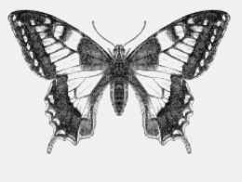
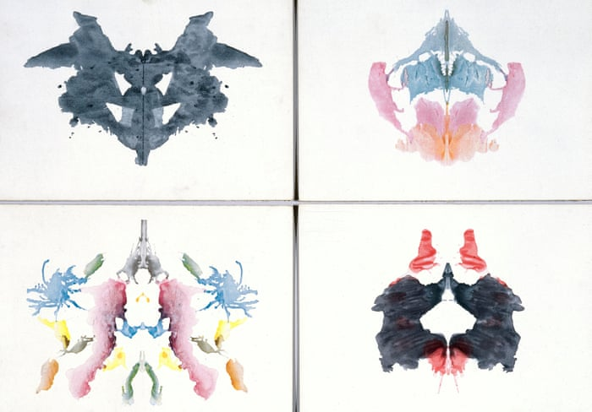
You too can make symmetric designs like these using ink blots!
Click here for instructions!

Slide 7
You can make symmetric designs like these using inked strings too!
Click here to know how to make these

Slide 8
Guess these by their symmetric halves

Slide 9
Thank you!

Slide 10
Instructions:
Go back

Slide 11
Instructions:
Go back

