Slide 1
KEY ELEMENTS OF A DEMOCRATIC GOVERNMENT
SOCIAL AND POLITICAL LIFE-l
CLASS-Vl
MODULE:2/2

Slide 2
Revision-1/2
Democracy has certain key elements.
Like participation, conflict resolution and concern for equality and justice.
Apartheid means racial segregation.
It was followed in South Africa.
It led to discrimination against non-European groups.
South African people were divided into white, black, Indian and coloured races.
Hector Piterson was killed in 1976.

Slide 3
Key Topics
Democracy-Key elements
Participation
Other ways of Participation
Need to resolve Conflict
Equality and Justice

Slide 4
Democracy- Elements
Democracy has certain key elements which make it the most preferred form of government today. These elements include participation, accountability, conflict resolution and concern for equality and justice.

Slide 5
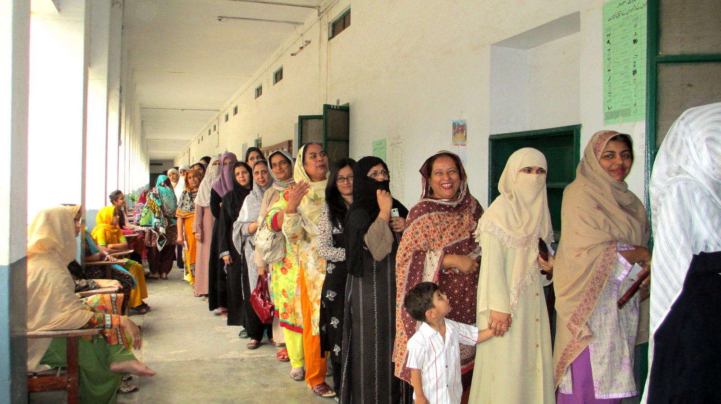
Participation
What does participation mean?
Means to take part in.
In a democracy, every citizen has the right to participate in the decision making process of the government.

Slide 6
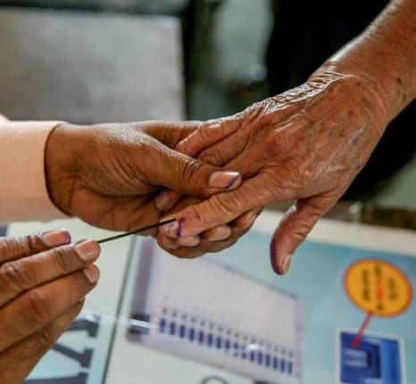
participation
In a democracy, there is a free and fair system of election for choosing representatives to the government. All these governments are elected for fixed periods.

Slide 7
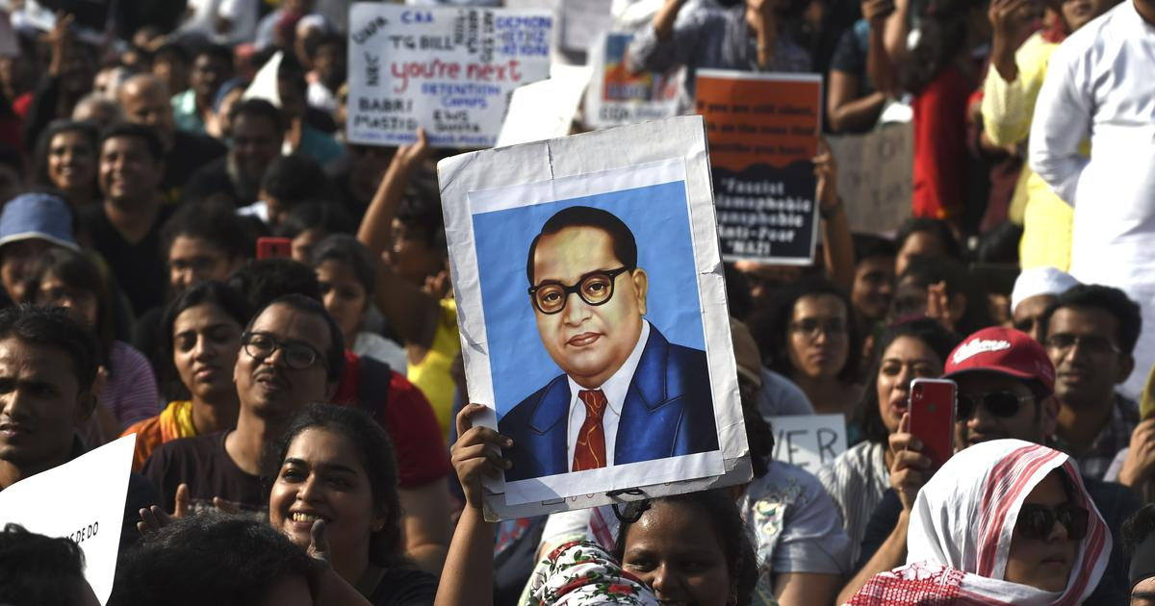
Other ways of participation
Elections are usually held once in five years. besides voting there are other ways of participating in the process of government in democracy.
Ex. Rallies, signature campaign, dharnas, strikes.

Slide 8
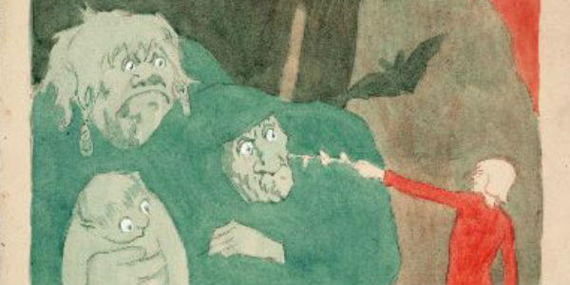
Need to Resolve Conflict
Conflicts occur in democracy, when people of different cultures, religions or economical backgrounds do not get along with each other, or when some among them feel they are being discriminated against.

Slide 9
Water Disputes
Rivers too can become a source of conflict between states. A river may begin in one state, flow through another and end in a third state. The sharing of river water between different states that the rivers goes through is becoming an issue of conflict.
Ex. The Cauvery water dispute

Slide 10
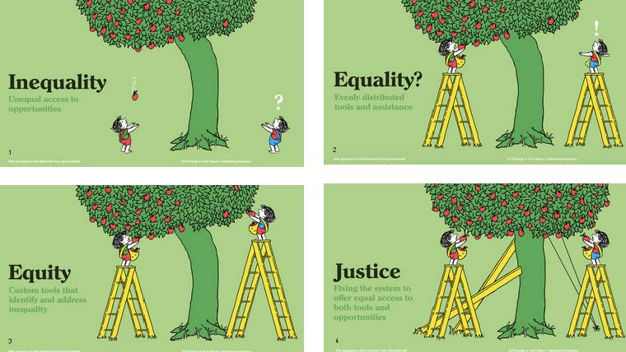
Equality and Justice
One of the key ideas of a democratic government is its commitment to equality and justice. Equality and justice are inseparable. Equality is the pre-condition that ensures justice to all the people of a country.

Slide 11
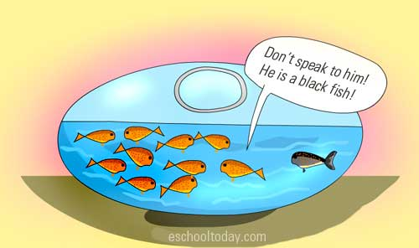
Different types of inequalities in India
Social inequality
Gender inequality
Income inequality

Slide 12
THANK YOU

