Slide 1
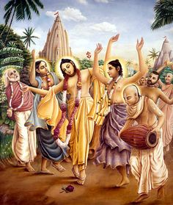
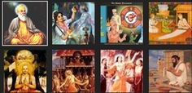
DEVOTIONAL PATH TO THE DIVINE

Slide 2
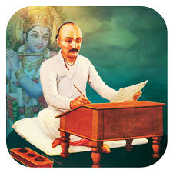
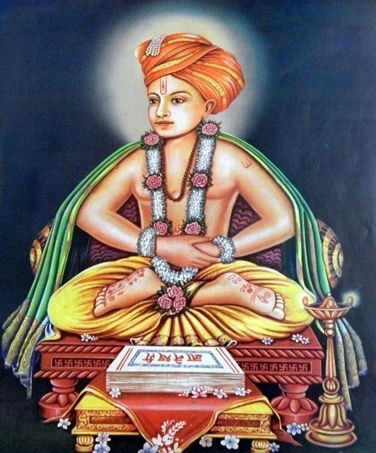
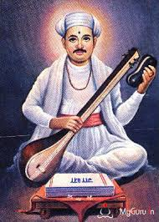
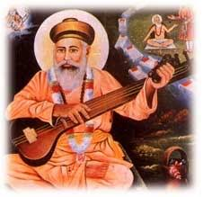
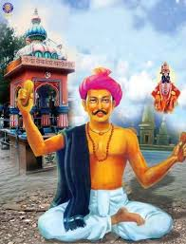
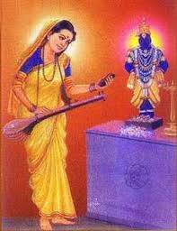
THE SAINTS OF MAHARASHTRA
Jnaneshwar
Tukaram
Eknath
Chokhamela
Namdev
Sakhubai

Slide 3
THE SAINTS OF MAHARASHTRA
Jnaneshwar, Namdev, Eknath, Tukaram, Sakkubai and the family of Chokhamela focused on the bhakti of Vitthala (a form of Vishnu).
Some of these belonged to lower castes.
They rejected all forms of ritualism, outward display of piety and social differences based on birth.

Slide 4
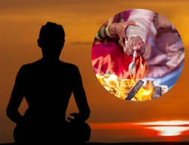
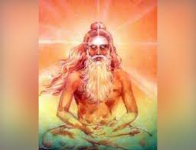
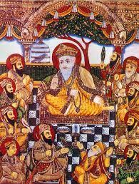
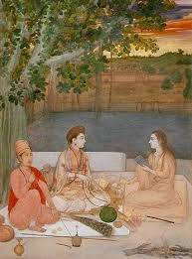
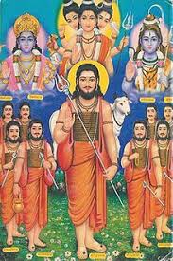
Nathpanthis, Siddhas & Yogis

Slide 5
Nathpanthis, Siddhas and Yogis
A number of religious groups that emerged during this period criticized the ritual and other aspects of conventional religion and the social order, using simple, logical arguments.
Among them were the Nathpanthis, Siddhcharas and Yogis.
They advocated renunciation of the world.

Slide 6
For them, the path to salvation lay in meditation on the formless Ultimate Reality and the realisation of oneness with it.
They advocated intense training of the mind and body through practices like yogasanas, breathing exercises and meditation to achieve this.
These groups became particularly popular among “low” castes.
Their criticism of conventional religion created the ground for devotional religion to become a popular force in northern India.

Slide 7
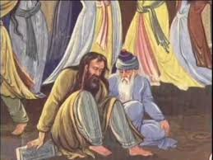
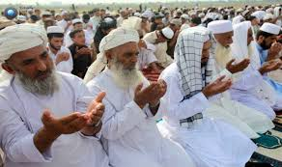
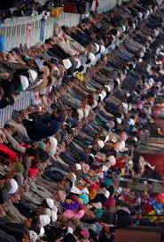
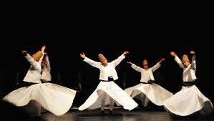
Islam & Sufism

Slide 8
Islam and Sufism
Islam propagated monotheism or submission to one God. ‘
It also rejected idol worship. Muslim scholars developed a holy law called Shariat.
The Sufis rejected the elaborate codes of behaviour demanded by Muslim religious scholars.
The sought unison with God, as a lover seeks his beloved with a disregard for the world.
Among the great Sufis of Central Asia were Ghazzali, Rumi and Sadi.
Sufism introduced many popular orders or silsilas of which the most widespread was the Shariat and Chisti Silsilas.
The Chisti silsila was among the most influential orders. A long line of teachers included Khwaja Moinuddin Chisti of
Ajmer, Qutbuddin Bakhtiyar Kaki of Delhi, Baba Farid of Punjab, Khwaja Nizamuddin Auliya of Delhi and Bandanawaz Gisudaraz of Gulbarga.

Slide 9
Nancy George
AECS, Mysore

