Slide 1
CLASS 8 SCIENCE FORCE AND PRESSURE-MODULE 5 ON AIR PRESSURE
Mrs.Geeta Gupta
A.E.C.S -1,Mumbai

Slide 2
AIR PRESSURE
What is air pressure?
Atmospheric pressure
Atmospheric pressure varies with height
Applications of atmospheric pressure

Slide 3
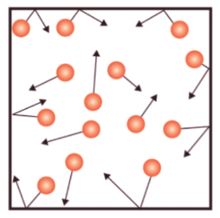
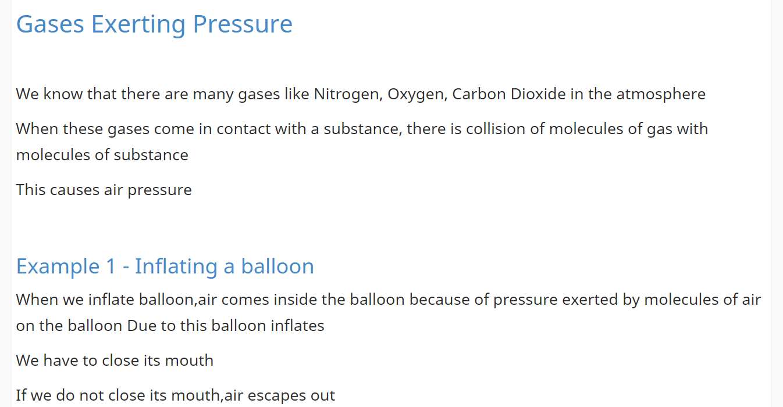
Gaseous pressure
Gases exert the same pressure on the walls of the container in all directions.

Slide 4
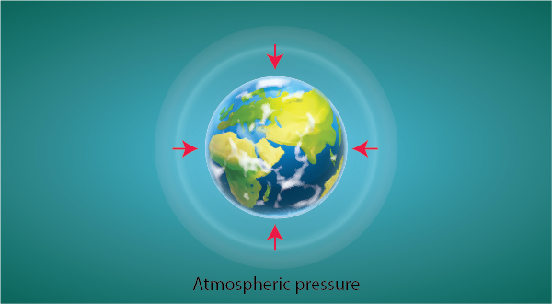
Our atmosphere extends to several kilometres above sea level. The weight of the air acts as pressure known as atmospheric pressure. The pressure in our body balances the atmospheric pressure and that is why we do not feel it.
ATMOSPHERIC PRESSURE

Slide 5
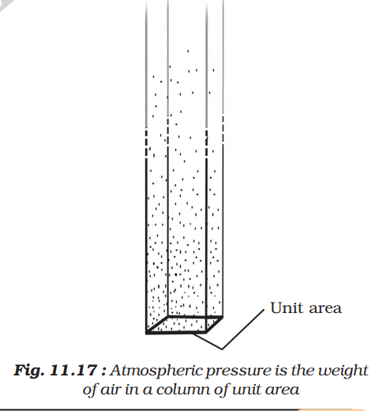
ATMOSPHERIC PRESSURE
If we imagine a unit area and a very long cylinder standing on it filled with air, then the weight of the air in this cylinder is the atmospheric pressure

Slide 6
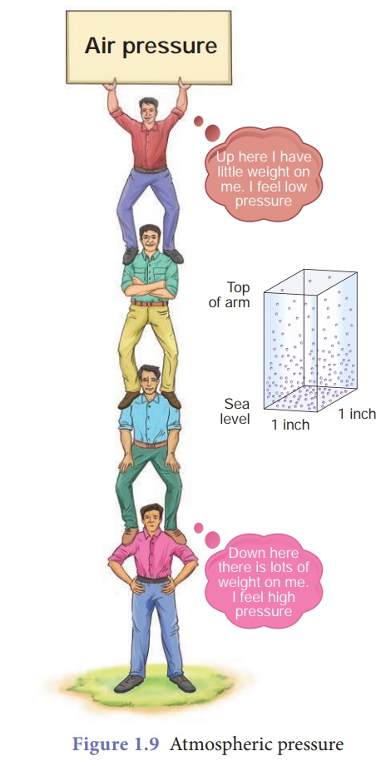
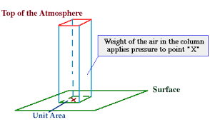

Slide 7
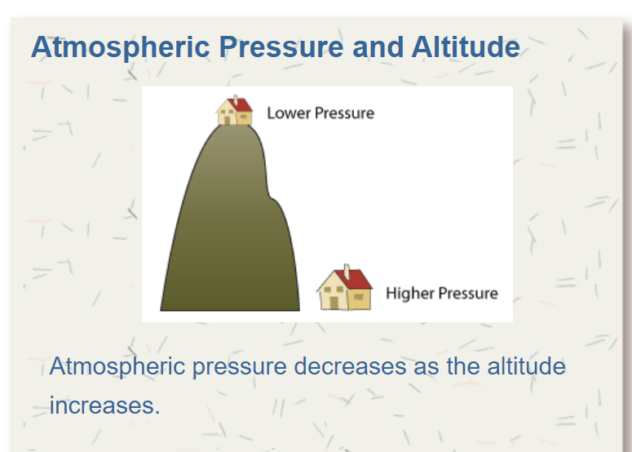
Title Layout
Subtitle

Slide 9
PRESSURE OF ATMOSPHERE ON OUR HEAD
The reason we are not crushed under this weight is that the pressure inside our bodies is also equal to the atmospheric pressure and cancels the pressure from outside

Slide 10
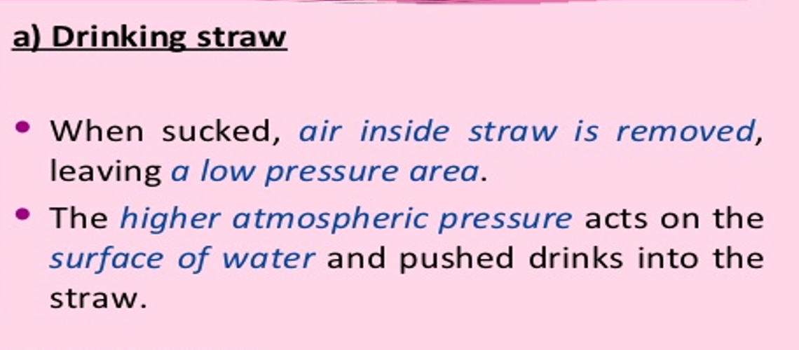
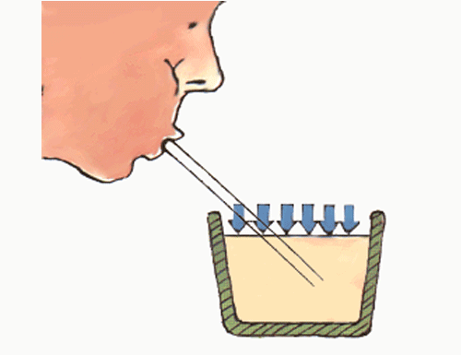

Slide 12
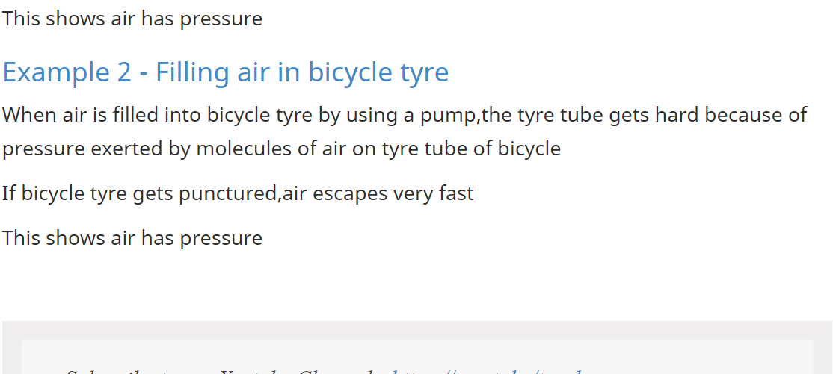
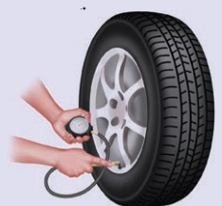

Slide 13
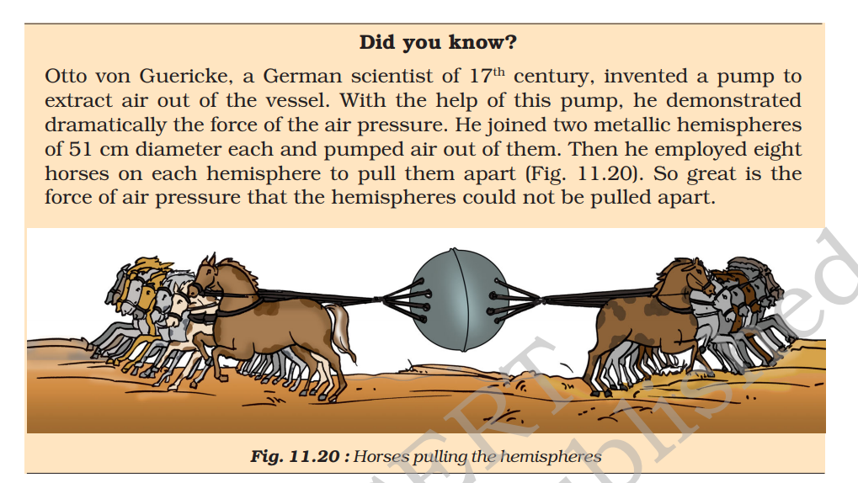

Slide 14
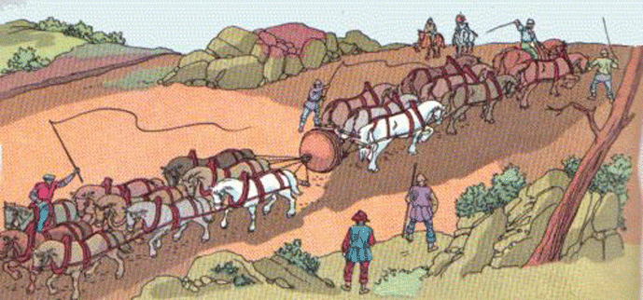

Slide 15
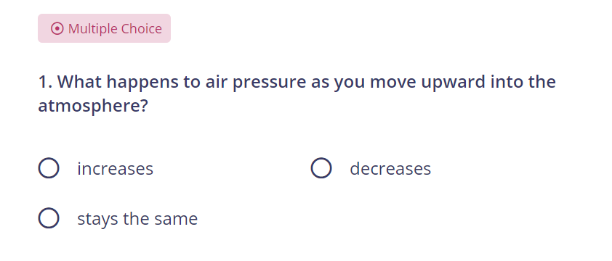
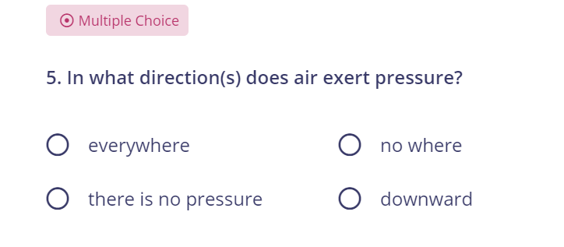

Slide 16
Add a Slide Title - 2

