Slide 1
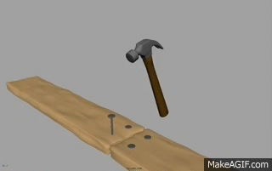
CLASS 8 SCIENCE FORCE AND AREA MODULE 3 ON PRESSURE
Mrs Geeta Gupta
A.E.C.S. 1,Mumbai

Slide 2
PRESSURE
POINTS COVERED
Relationship between force and pressure
Definition
Formula for calculating pressure
Everyday examples

Slide 3
RELATIONSHIP BETWEEN FORCE AND PRESSURE
Pressure is a measure of how much force is acting upon an area.

Slide 4
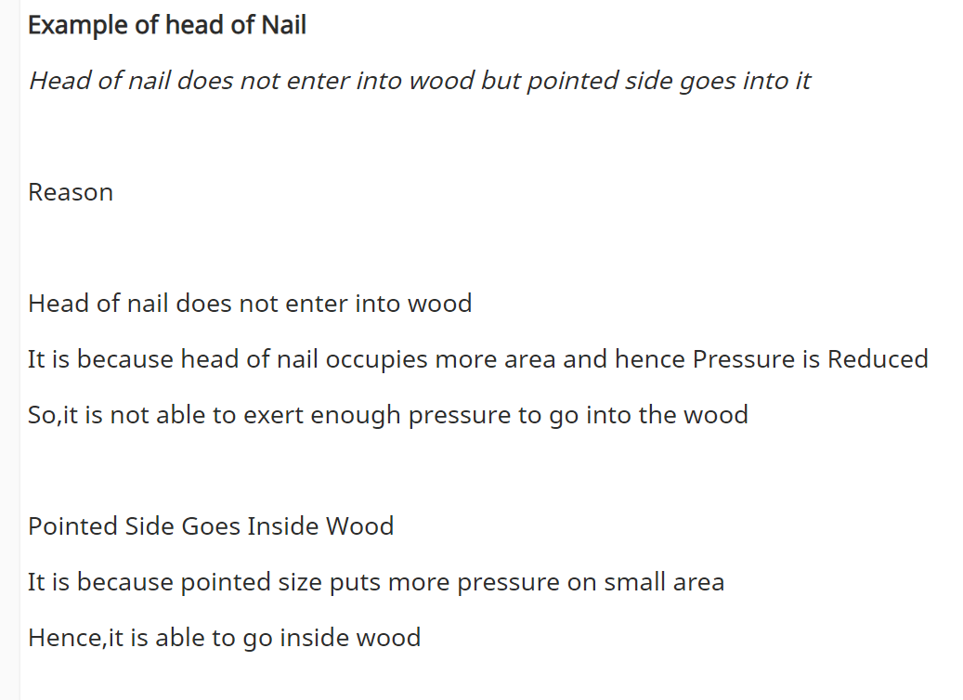

Slide 5
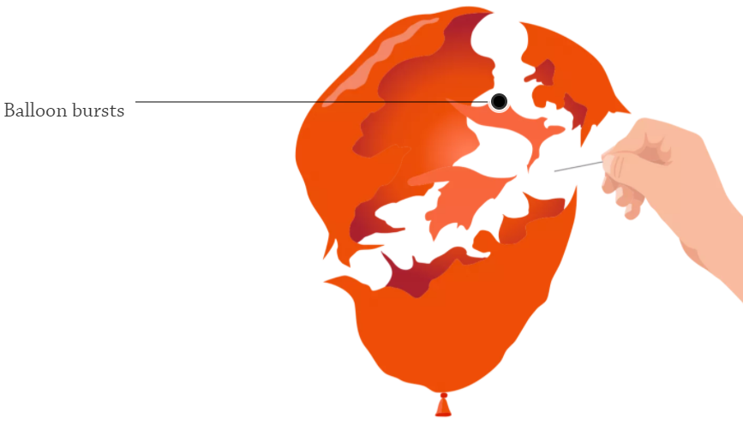
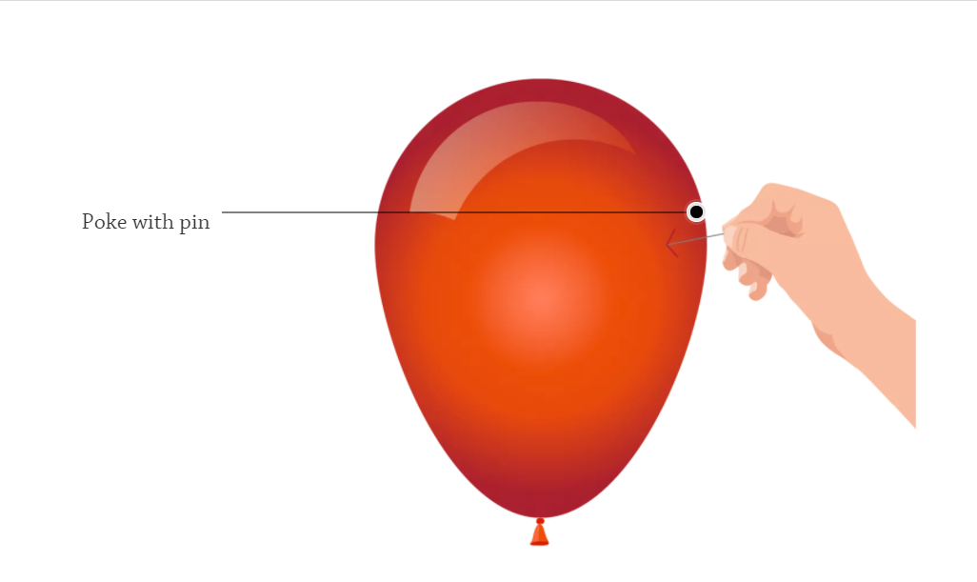
By concentrating a force into a small space(increasing the pressure),we can make do more than it would if it were spread out

Slide 6
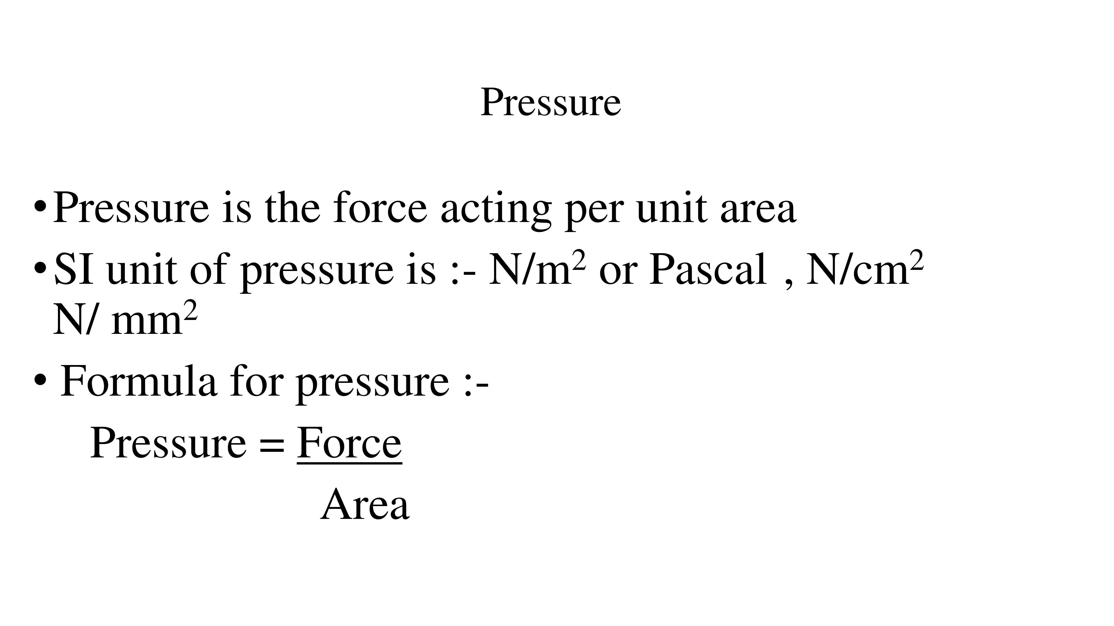

Slide 7
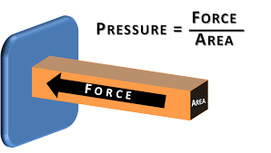
CALCULATING PRESSURE

Slide 11
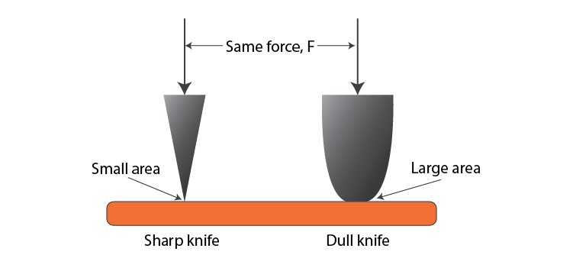
DISTRIBUTION OF PRESSURE
Force acting on a smaller area applies more pressure than the same force acting on a larger area.
Examples: Porters place a round cloth on their heads to increase surface area and reduce pressure.

Slide 12
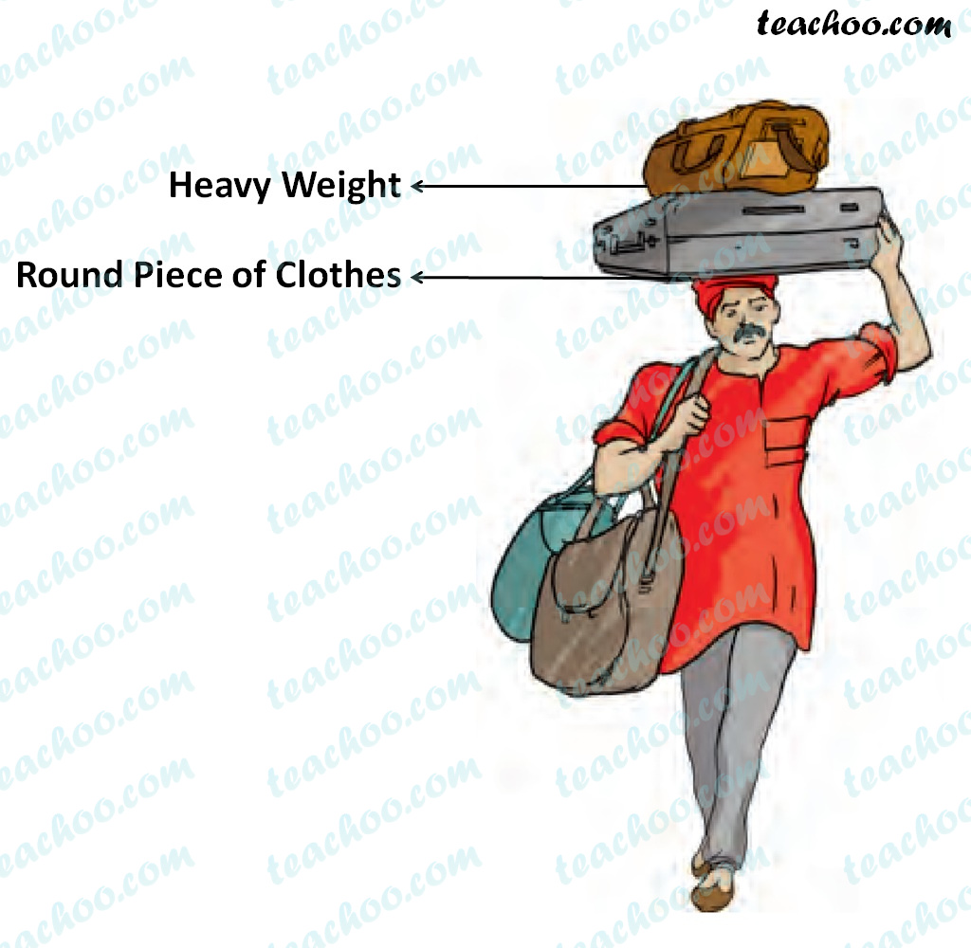
Example: Porters place a round cloth on their heads to increase surface area and reduce pressure.

Slide 13
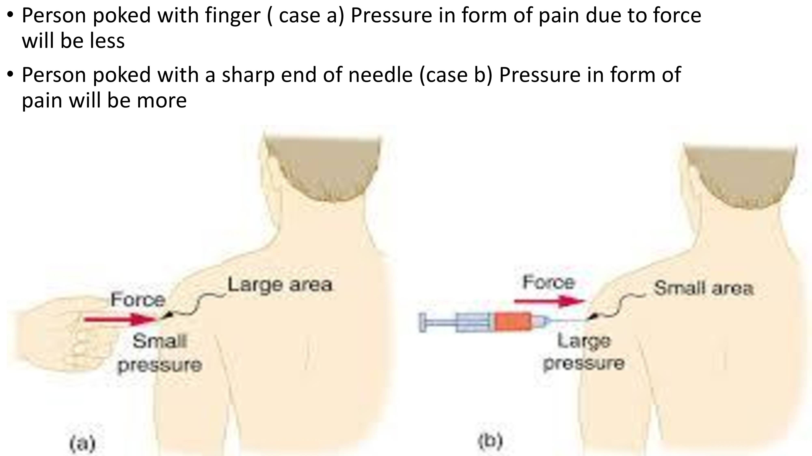

Slide 20
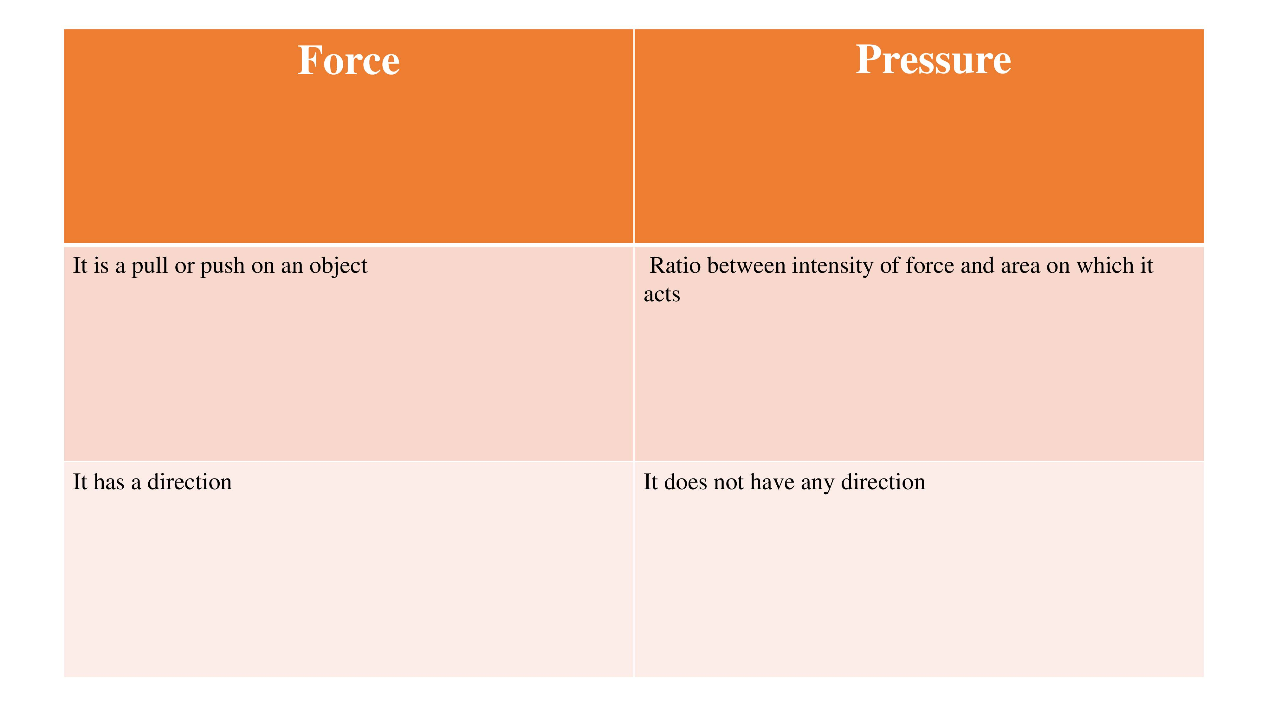
DIFFERENCE BETWEEN FORCE AND PRESSURE

