Slide 1
CLASS :VIII L-11 FORCE AND PRESSURE
(MODULE 1 on Force)
Mrs.Geeta Gupta
A.E.C.S. 1,Mumbai

Slide 2
MODULE 1
What is force?
Definition of push, pull, force
Conditions necessary for force
Effects of force
Magnitude of force

Slide 3
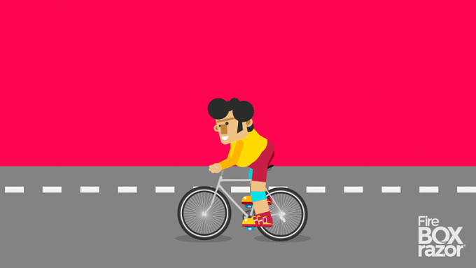
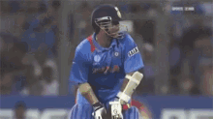
WORLD FULL OF MOTION

Slide 4
Examples of Force
FORCE TO STOP THE BALL
FORCE TO CHANGE DIRECTION OF BALL

Slide 6
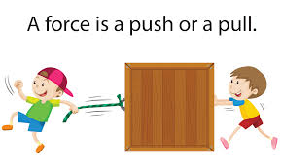
WHAT IS FORCE ?

Slide 7
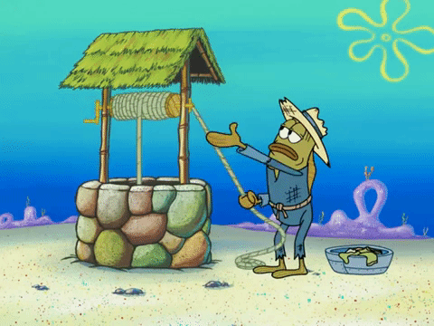
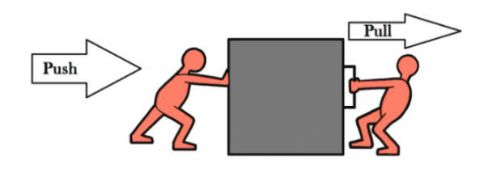
Push
A push is a force exerted away from the body, e.g: Hitting a snooker ball, kicking a football.
Pull
A pull is a force exerted towards the body, e.g: drawing a bucket of water from a well, playing tug of war.

Slide 8
FORCES ARE DUE TO AN INTERRACTION
To let a force come into play, two or more objects must interact with each other.

Slide 9
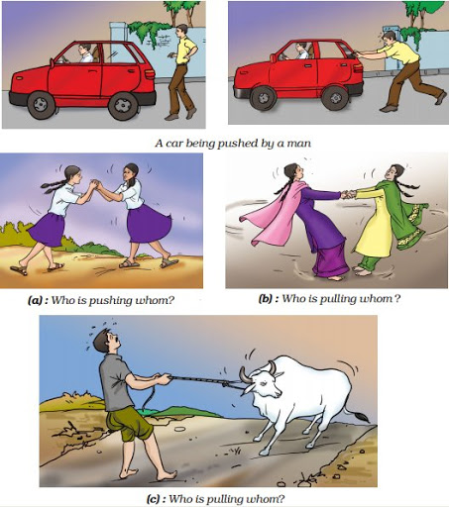
EVERYDAY ACTIVITIES INVOLVING INTERRACTION

Slide 11
SUMMARY

Slide 12
EXPLORING FORCES :MAGNITUDE
Tug of war :When 2 teams pull equally hard,the rope does not move in any direction
Forces applied in same direction add to one another
If Forces applied in opposite directions on an object ,net force is the difference between the 2 forces

Slide 13
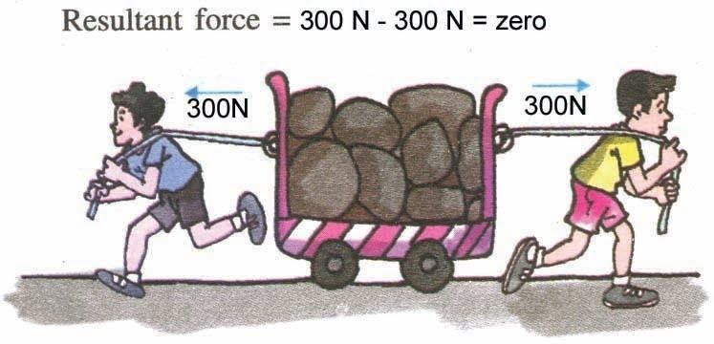
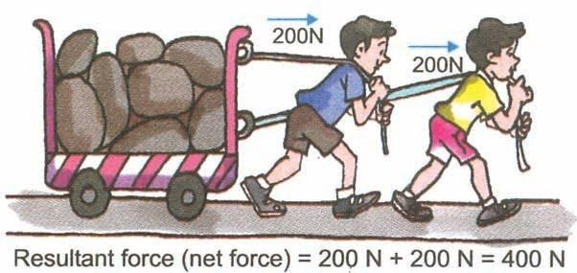
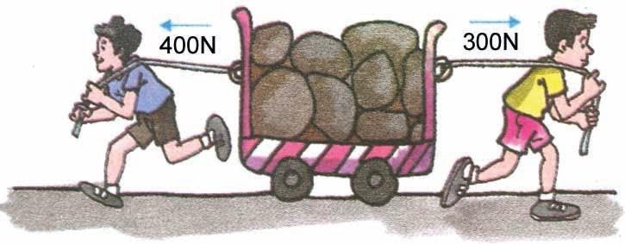
Net force
The resultant of all the forces acting on a body is known as net force.
Resultant force = 400 – 300 100 N

Slide 14
Push or pull?

