Slide 1
Class VIII – Mathematics Chapter – 7 Cubes and Cube Roots
Module 1 of 3
Prepared by
Sumithra Madathil
TGT(Maths/Physics)
A E C S – 2 , Mumbai

Slide 2
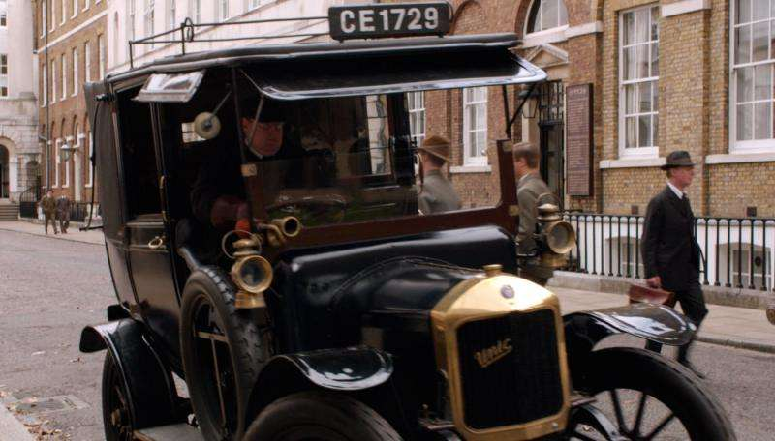
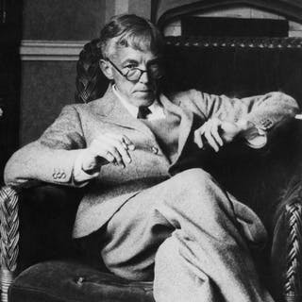
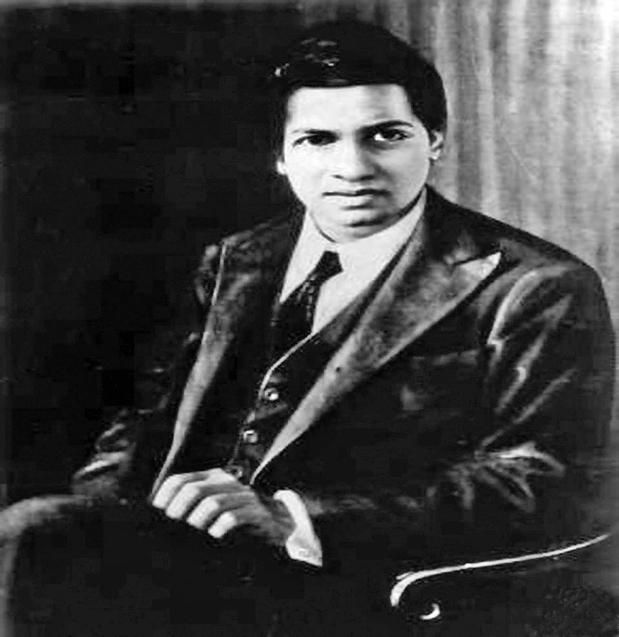
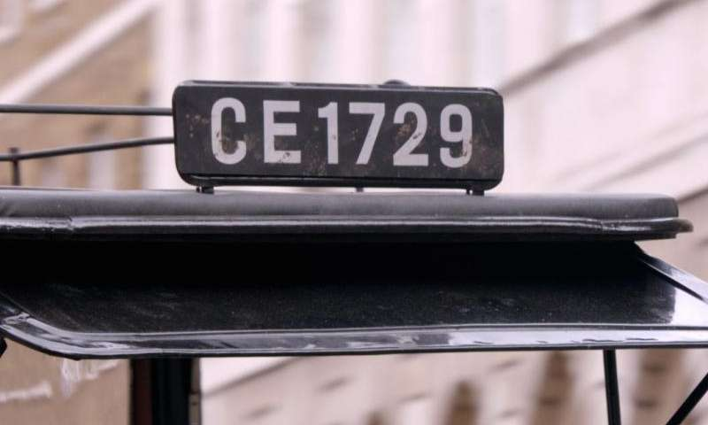
An interesting story….
G H Hardy
Srinivasa Ramanujan

Slide 3
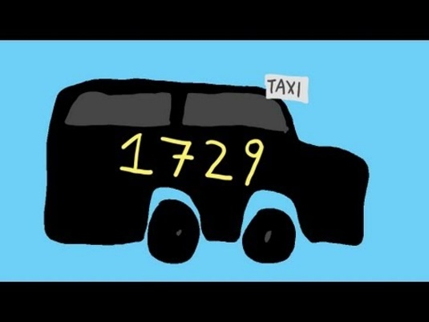
This is a story about one of India’s great mathematical geniuses, Srinivasa Ramanujan.
Once another famous mathematician and his friend Prof. G.H. Hardy came to visit him in a taxi whose number was 1729.
While talking to Ramanujan, Hardy said……..

Slide 4
My taxi number,1729, is a dull number.
No, my friend. 1729 is indeed interesting. It is the smallest number that can be expressed as a sum of two cubes in two different ways.

Slide 5
Hardy – Ramanujan Number
1729 = 1728 + 1 = 12³ + 1³
1729 = 1000 + 729 = 10³ + 9³
1729 has since been known as the Hardy – Ramanujan Number, even though this feature of 1729 was known more than 300 years before Ramanujan.

Slide 6
.
1729 is the smallest Hardy– Ramanujan Number.
There are an infinitely many such numbers.
Example: (i) 4104 = 2³ + 16³ = 8 + 4096
4104 = 9³ + 15³ = 729 + 3375
(ii) 13832 = 18³ + 20³ = 5832 + 8000
13832 = 2³ + 24³ = 8 +13824

Slide 7
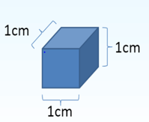
CUBES
The word ‘cube’ is used in geometry.
A cube is a solid figure which has all its sides equal.
Figures which have 3-dimensions are known as solid figures.

Slide 8
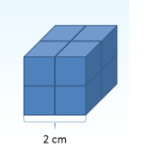
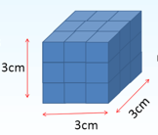
.
How many cubes of side 1 cm will make a cube of side 2 cm?
8 cubes of side 1 cm will make a cube of side 2 cm.
How many cubes of side 1 cm will make a cube of side 3 cm?
27 cubes of side 1cm will make a cube of
side 3cm.

Slide 9
.
The numbers 1, 8, 27, ... are called perfect cubes or cube numbers.
Each of them is obtained when a number is multiplied by taking it three times.
1 = 1 × 1 × 1 = 1³
8 = 2 × 2 × 2 = 2³
27 = 3 × 3 × 3 = 3³
64 = 4 x 4 x 4 = 4³
………

Slide 10
.

Slide 11
Cubes of numbers from 1 to 10.
Cubes of even numbers are even.
Number | Cubes
1 | 1³ = 1
2 | 2³ = 8
3 | 3³ = 27
4 | 4³ = 64
5 | 5³ = 125
6 | 6³ = 216
7 | 7³ = 343
8 | 8³ = 512
9 | 9³ = 729
10 | 10³ = 1000
Cubes of odd numbers are odd.

Slide 12
.
There are only ten perfect cubes from 1 to 1000.
They are :
1³ = 1 x 1 x 1 = 1
2³ = 2 x 2 x 2 = 8
3³ = 3 x 3 x 3 = 27
4³ = 4 x 4 x 4 = 64
5³ = 5 x 5 x 5 = 125
6³ = 6 x 6 x 6 = 216
7³ = 7 x 7 x 7 = 343
8³ = 8 x 8 x 8 = 512
9³ = 9 x 9 x 9 = 729
10³ = 10 x 10 x 10 = 1000
The one’s digit of the cube of a number
ending in 1 is 1,
ending in 2 is 8,
ending in 3 is 7,
ending in 4 is 4,
ending in 5 is 5,
ending in 6 is 6,
ending in 7 is 3,
ending in 8 is 2,
ending in 9 is 9,
ending in 0 is 0.

Slide 13
Some properties of cube numbers/perfect cubes
1. Cubes of even numbers are always even.
Example: 2 ³ = 8
4 ³ = 64
6 ³ = 216
12 ³ = 1728 etc.
2. Cubes of odd numbers are always odd.
Example: 1 ³ = 1
3 ³ = 27
5 ³ = 125
11 ³ = 1331 etc.
3. The cube of a negative number is always negative.
Example: (– 3)³ = (–3) x (–3) x (–3) = (– 27)
(– 9)³ = (–9) x (–9) x (–9) = (–729)
(– 14)³ = (–14) x (–14) x (–14) = (– 2744)

Slide 14
.
4. (a) If the one’s digit of a number is 1, then the one’s digit of its cube is also 1.
Example: 11 ³ = 1331
(b) If the one’s digit of a number is 2, then the one’s digit of its cube is 8.
Example: 12 ³ = 1728
(c) If the one’s digit of a number is 3, then the one’s digit of its cube is 7.
Example: 23 ³ = 12167
(d) If the one’s digit of a number is 4, then the one’s digit of its cube is also 4.
Example: 14 ³ = 2744

Slide 15
.
(e) If the one’s digit of a number is 5, then the one’s digit of its cube is also 5.
Example: 25 ³ = 15625
(f) If the one’s digit of a number is 6, then the one’s digit of its cube is also 6.
Example: 16 ³ = 4096
(g) If the one’s digit of a number is 7, then the one’s digit of its cube is 3.
Example: 17 ³ = 4913

Slide 16
.
(h) If the one’s digit of a number is 8, then the one’s digit of its cube is 2.
Example: 18 ³ = 5832
(i) If the one’s digit of a number is 9, then the one’s digit of its cube is also 9.
Example: 19 ³ = 6859
5. Number of zeroes at the end of a perfect cube is always a multiple of 3. So the number of zeroes at the end of a perfect cube can be 3, 6, 9, 12, ….
Example: 1000, 8000, 27000000, 1728000, 64000000000 etc. are all perfect cubes.

Slide 17
Practice Time ….
1. How many perfect cubes are there from 1 to 100?
There are only four perfect cubes from 1 to 100.
They are 1, 8, 27 and 64.
2. (i) The one’s digit of the cube of 149 is 9.
(ii) The one’s digit of the cube of 77 is 3.
(iii) The one’s digit of the cube of 5022 is 8.

Slide 18
.
3. Find the cubes of the following numbers:
(a) 50
Cube of 50, 50 ³ = 50 x 50 x 50
= 125000
(b) 72
Cube of 72 , 72 ³ = 72 x 72 x 72
= 373248
(c) 300
Cube of 300, 300 ³ = 300 x 300 x 300
= 27000000
Observe the number of zeroes

Slide 19
.
4. Is 9 a perfect cube ?
No, as 9 = 3 × 3 and there is no natural number which multiplied by taking it three times gives 9.
This shows that 9 is not a perfect cube.
5. Is 1728 a cube number?
Yes, as 1728 is obtained by multiplying the number 12 three times; it is a cube number or a perfect cube.
1728 = 12 x 12 x 12

Slide 20
What have we discussed ?
Numbers like 1729, 4104, 13832, are known as Hardy – Ramanujan Numbers. They can be expressed as the sum of two cubes in two different ways.
Numbers obtained when a number is multiplied by itself three times are known as cube numbers or perfect cubes . For example 1, 8, 27, ... etc.
Cubes of even numbers are even.
Cubes of odd numbers are odd.
Determining the one’s digit of cube of a number
^*^*^*^*^*^*

Slide 21
.
End of Module 1 of 3

