Slide 1
Class 8 English MODULE 3
LESSON 10: THE GREAT STONE FACE

Slide 3
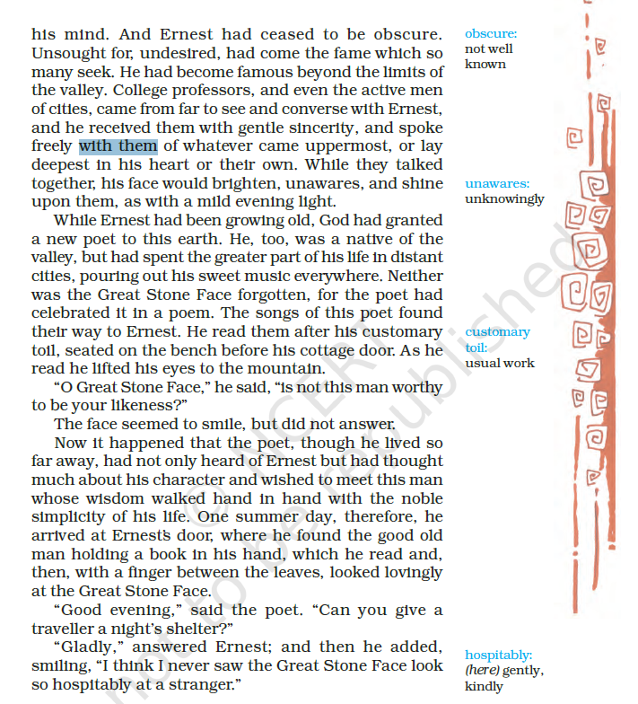

Slide 4
