Slide 1
By Thomas Hardy
When I set out for Lyonnesse

Slide 2
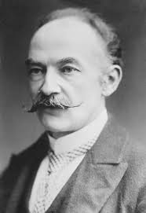
Poet Name | Thomas Hardy
Born | 2 June 1840, Stinsford, United Kingdom
Died | 11 January 1928, Dorchester, United Kingdom
Poems | The Darkling Thrush, Neutral Tones, The Man He Killed
Movies | Far from the Madding Crowd, The Mayor of Casterbridge

Slide 3
rime: frost formed on cold objects by the rapid freezing of water vapour in cloud or fog lonesomeness : a state for feeling lonely sojourn : a temporary stay bechance: to happen or find by chance mute : silent surmise : suppose that something is true without having evidence to confirm it radiance : light or heat as emitted or reflected by something fathomless: something unable to be measured or understood
Meanings of words and phrases:

Slide 4
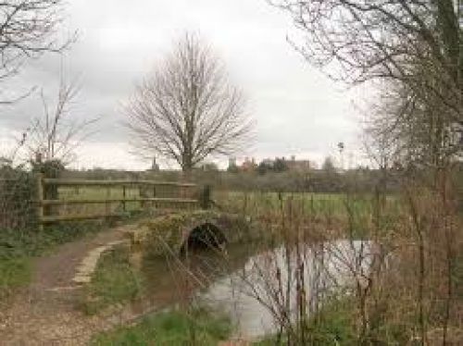
The path to Lyonnesse

Slide 5
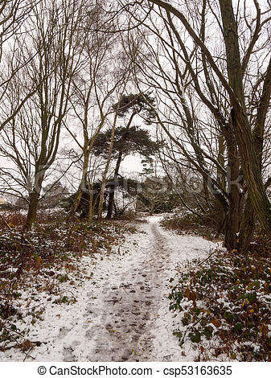
The path to Lyonnesse in winter

Slide 6
The star lighted sky

Slide 7
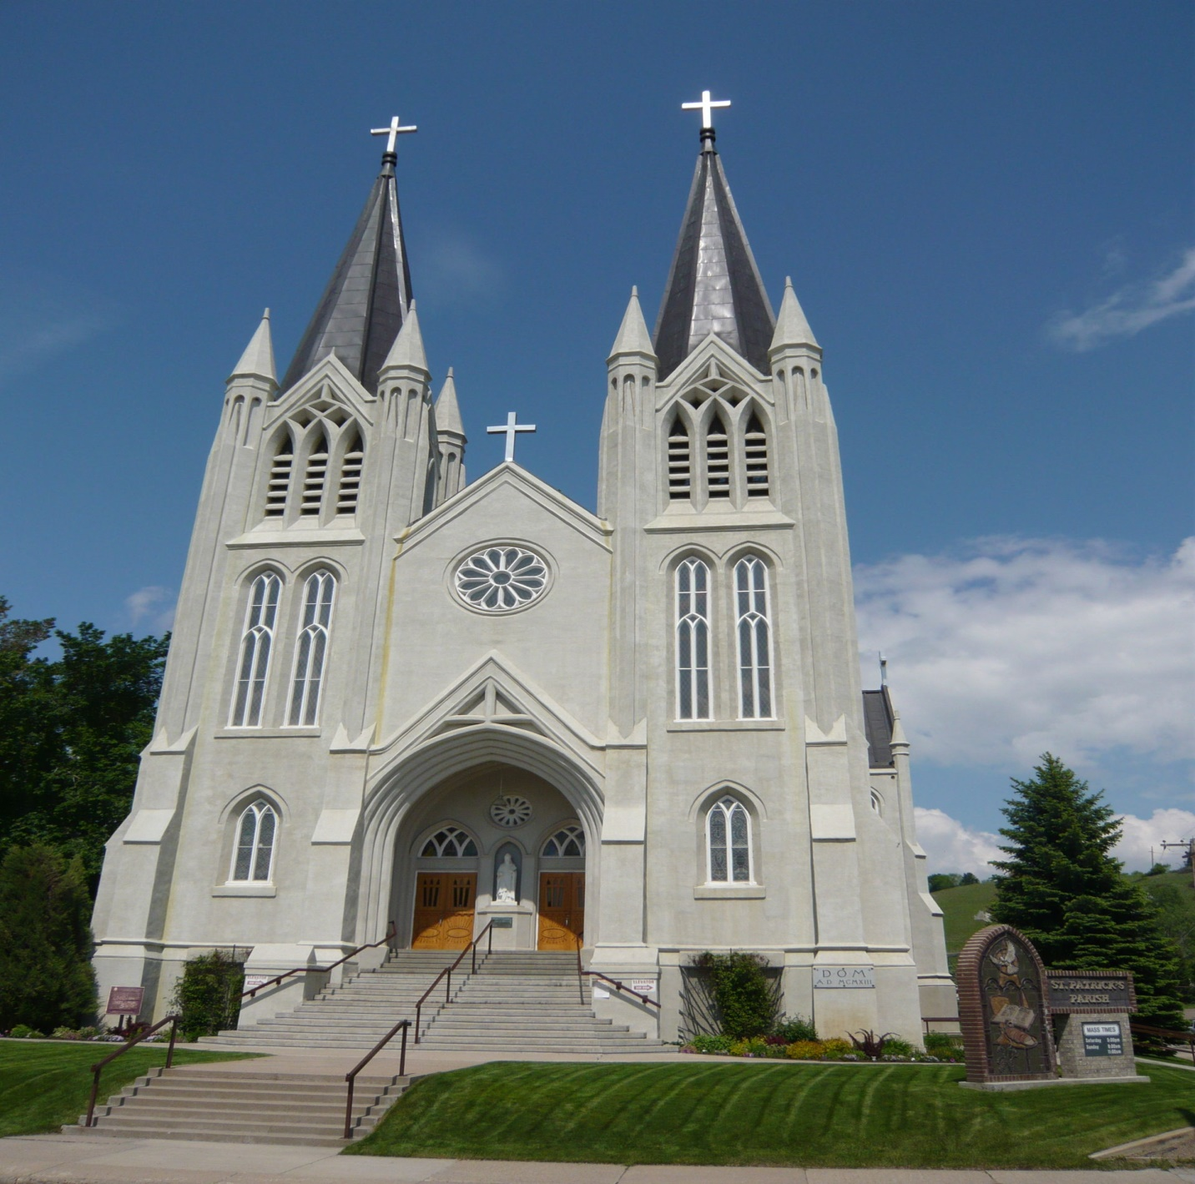
The church building

Slide 8
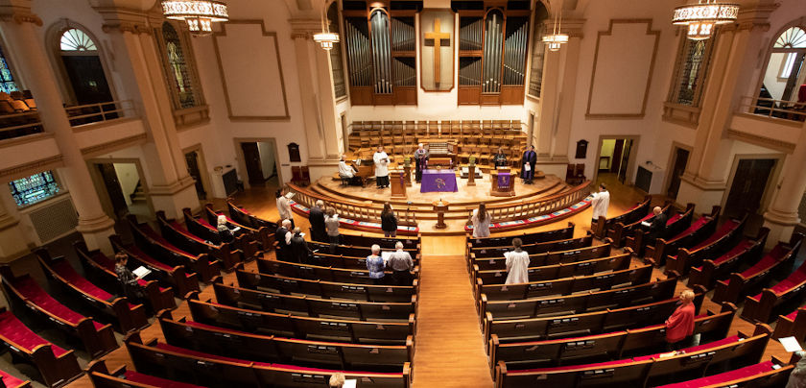
The inside view of a church building

Slide 9
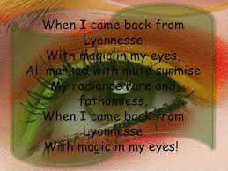

Slide 10
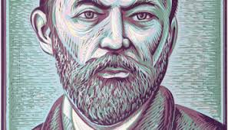
Thomas Hardy’s transformed eyes
(Drawing)

Slide 11
END

