Slide 1
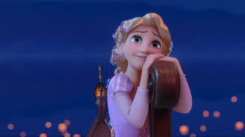
English Supplementary – Class VIII Chapter 5 Princess September
Notes:
1

Slide 2
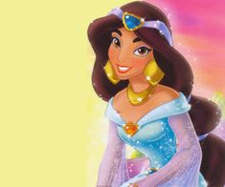
DISPLAYING LOVING-KINDNESS TO ALL LIFE FORMS
A girl’s kindness to a bird and the bird’s reciprocal feelings for her
Authored by Somerset Maugham

Slide 3
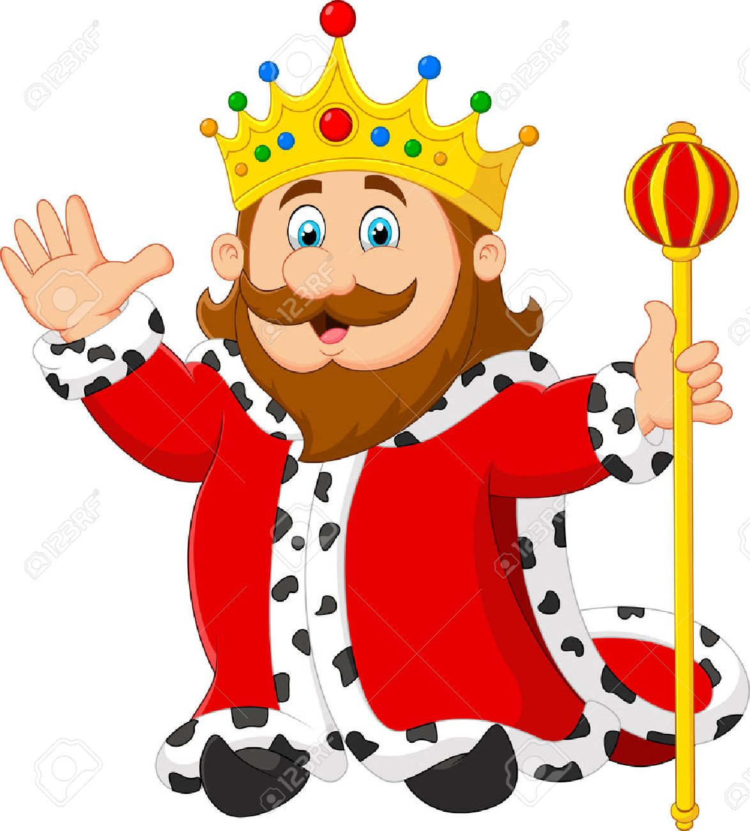
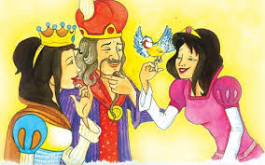
The Royal Family
The King and Queen of Thailand had many daughters. The youngest was September.
The King had a habit of giving away presents on his birthday. He gave his daughters caged parrots on the birthday.

Slide 4
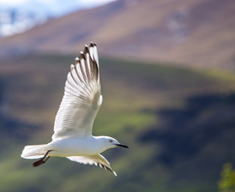
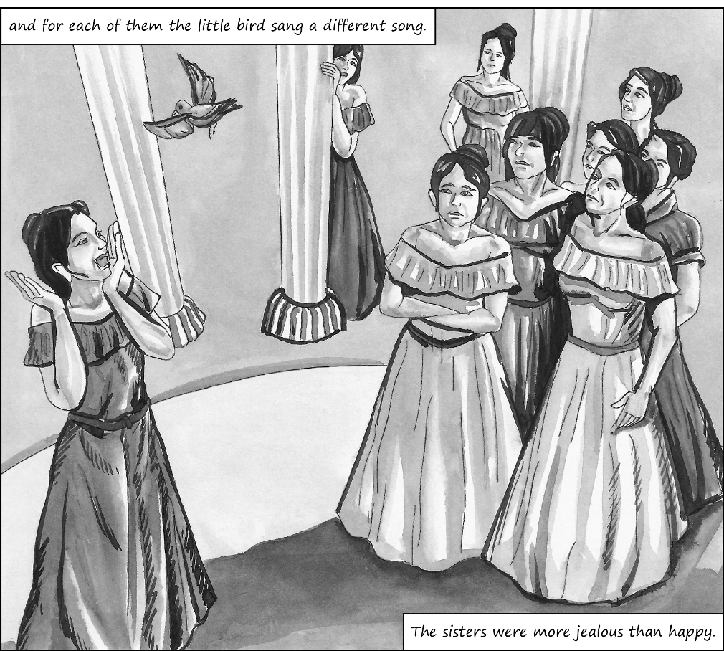
Entry of the little bird
The parrot belonging to Princess September died one day. September was very sad and lay crying. Then a little bird came and sang to her. This made her very happy.
The Princess wanted to show the bird to her eight sisters. Their parrots would only say ‘Pretty Polly’ but this bird sang.

Slide 5
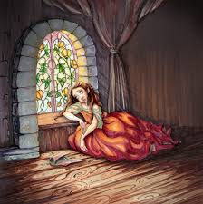
The Little Bird’s Visit and the Princess’s Worry
The little bird would sing merrily. He would fly around the room without any fear. One day, the bird went to meet his father-in–law.
Working upon her anxieties, the sisters asked September to put the bird in a cage. The Princess did not want to, but she is influenced by her sisters.

Slide 6
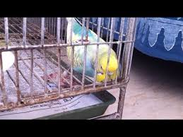
The plight of the caged bird
When the little bird came back, the Princess caged him. The bird stopped singing. He wouldn’t eat. He fell sick. He was on the verge of dying.
The princess felt his little heart. It was beating. Fearing that he might die soon, the princess put him outside the window. The bird was happy. It flew around and ate from the princess’ hand.

Slide 7
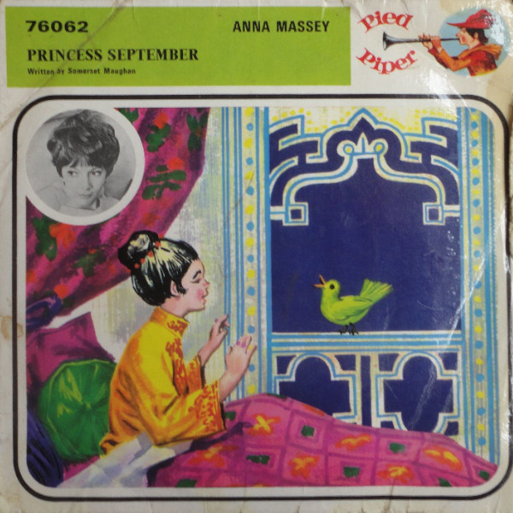
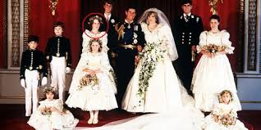
The marriage of Princess September
The bird never left the Princess. The window was always left open. Fresh air wafted in and rejuvenated the princess. These were blissful times.
When she grew up, she was married off to the King of Cambodia. She was ceremonially taken around the thoroughfares of the capital on a white caparisoned elephant.

Slide 8
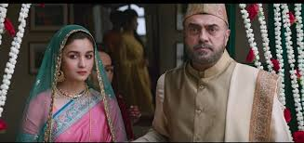
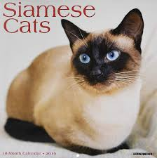
The marriage of other princesses
Her sisters, who kept their windows closed, remained ugly and were married off to the king’s councillors.
They were packed off with a pound of tea and a Siamese cat by way of dowry.

